Slide 1

CRYPTO: A SECURED CHATBOX
UNIVERSITY WITH A PURPOSE
Department of Cybernetics,
School of Computer Science
University Of Petroleum And Energy Studies
Mentor :
Mr. Sandip Kumar
Chaurasiya
Presented By:
Kartik Tyagi Sahil Sangwan Abhishek Joshi
R100218024 R100218050 R100218003

Slide 2
PROBLEM STATEMENT
To build a secured chat box/room in order to protect user’s data by using algorithm for encryption-decryption

Slide 3




Introduction
Socket Binding – TCP Layer
Chat Room
Sender
Receiver
Encryption
Decryption
Figure 1.1: A secured chat room

Slide 4



CREATION OF CHATROOM (using socket programming)
Socket Binding
Socket Binding
Chat Room Server
Sender
connect
connect
Receiver
Socket Binding
Listen
Accept
Send Data
Receive Data
If the connection request is successful
If the connection request is successful
Figure 1.2: Steps to create a chat room

Slide 5
Functionalities used to
create chatroom

Slide 6
fd=socket(protofamily, type, protocol)
Creates a new socket. Returns a file descriptor (fd). Must specify:
the protocol family (e.g. TCP/IP)
the type of service (e.g. STREAM or DGRAM)
the protocol (e.g. TCP or UDP)
close(fd)
Deletes socket.
For connected STREAM sockets, sends EOF to close connection.
bind(fd,laddress,laddresslen)
Used by server to establish port to listen on.
When server has >1 IP addrs, can specify “IF_ANY”, or a specific one
listen (fd, queuesize)
Used by connection-oriented servers only, to put server “on the air”
Queuesize parameter: how many pending connections can be waiting
afd = accept (lfd, caddress, caddresslen)
Used by connection-oriented servers to accept one new connection
There must already be a listening socket (lfd)
Returns afd, a new socket for the new connection, and
The address of the caller (e.g. for security, log keeping. etc.)

Slide 7
connect (fd, saddress, saddreslen)
Used by connection-oriented clients to connect to server
Used by connectionless clients to specify a “default send to address”
Subsequent “sends” don’t have to specify a destination address
int write (fd, data, length)
Used to send data
write is the “normal” write function; can be used with both files and sockets
int read (fd, data,length)
Used to receive data… parameters are similar!
There must already be a socket bound to a connection-oriented service on the fd
There must already be a listening socket on the server
You pass in the address (IP address, and port number) of the server.

Slide 8
ALGORITHM
06-12-2020
8

Slide 9
ALGORITHM FOR TCP CLIENT
Create socket,connectSocket
Do an active connect specifying the IP address and port number of server
Read and Write Data Into
connectSocket to Communicate with server
Close connectSocket

Slide 10
ALGORITHM FOR TCP SERVER
Create socket (serverSocket)
Bind socket to a specific port where clients can contact you
Register with the kernel your willingness to listen that on socket for client to contact you
Loop
Accept new connection (connectSocket)
Read and Write Data Into connectSocket to
Communicate with client
Close connectSocket
End Loop
Close serverSocket

Slide 11
ENCRYPTION (for secure communication)

Slide 12

What does encryption do?
Plain Text
[ Eg : HELLO]
Cipher Text
[Eg : OHSIE]
Encryption Algorithm
Fig 1.3: Human readable Plain Text is converted into un readable human format that is a cipher text

Slide 13
Key Exchange
Key Exchange Methods
Pre shared Secret
Key Exchange
Uses symmetric keys that is a single key pre shared key for both the end
Diffie Hellman
Key Exchange
Uses Assymetric Keys that is a pair of public and private keys for both ends

Slide 14



Diffie Hellman Key Exchange
Sender (Alice)
Prime number n
Recipient (Bob)
Generator
Private Key
Private Key
Alice’s Public Key (Alice + Generator)
Bob’s Public Key (Bob + Generator)
Fig 1.4 : A series of message exchange using a generator and a big prime number , generates public key for both Alice and Bob

Slide 15
ALGORTIHM FOR DIFFIE HELLMAN KEY EXCHANGE
Alice and Bob be two users with their respective private keys ‘a’ and ‘b’
Start
Accepting parameters public g, public n
Accepting private key for Alice ‘a’
Accepting private key for Bob ‘b’
Public Key generated by Alice and Bob ‘x’ and ‘y’
x=pow(g,a) mod n
y=pow(g,b) mod n
Interchange of public key
Generation of shared key by Alice and Bob
for Alice ka=pow(y,a) mod n
for Bob kb=pow(x,b) mod n
ka is same as kb and is also known as public key/secret key/shared key and is used to encrypt the messages
End

Slide 16
Encryption & Decryption : Diffie Hellman Key Exchange
Original Data
Sender (Alice)
Recipient (Bob)
Meet me
Encrypted Data
Private Key
ligjhfhinn huuut@##
Original Data
Bob’s public key has an essence of generator and his private key. This will help him to later decrypt the encrypted message
Bob is able to decrypt using his private key because there exists a mathematical relation between a private and public key
Meet me

Slide 17
IMPLEMENTED CODE
https://github.com/KartikTyagiS/Crypto-Secured-Chatbox

Slide 19
OUTCOMES

Slide 20
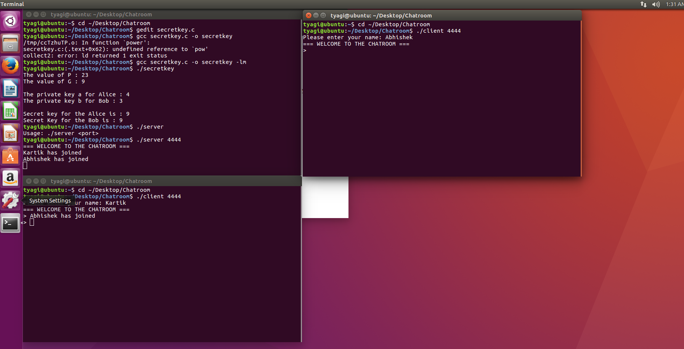
Chatroom with multiple client’s
This show’s the multiple client being connected to the server and communicating with each other

Slide 21
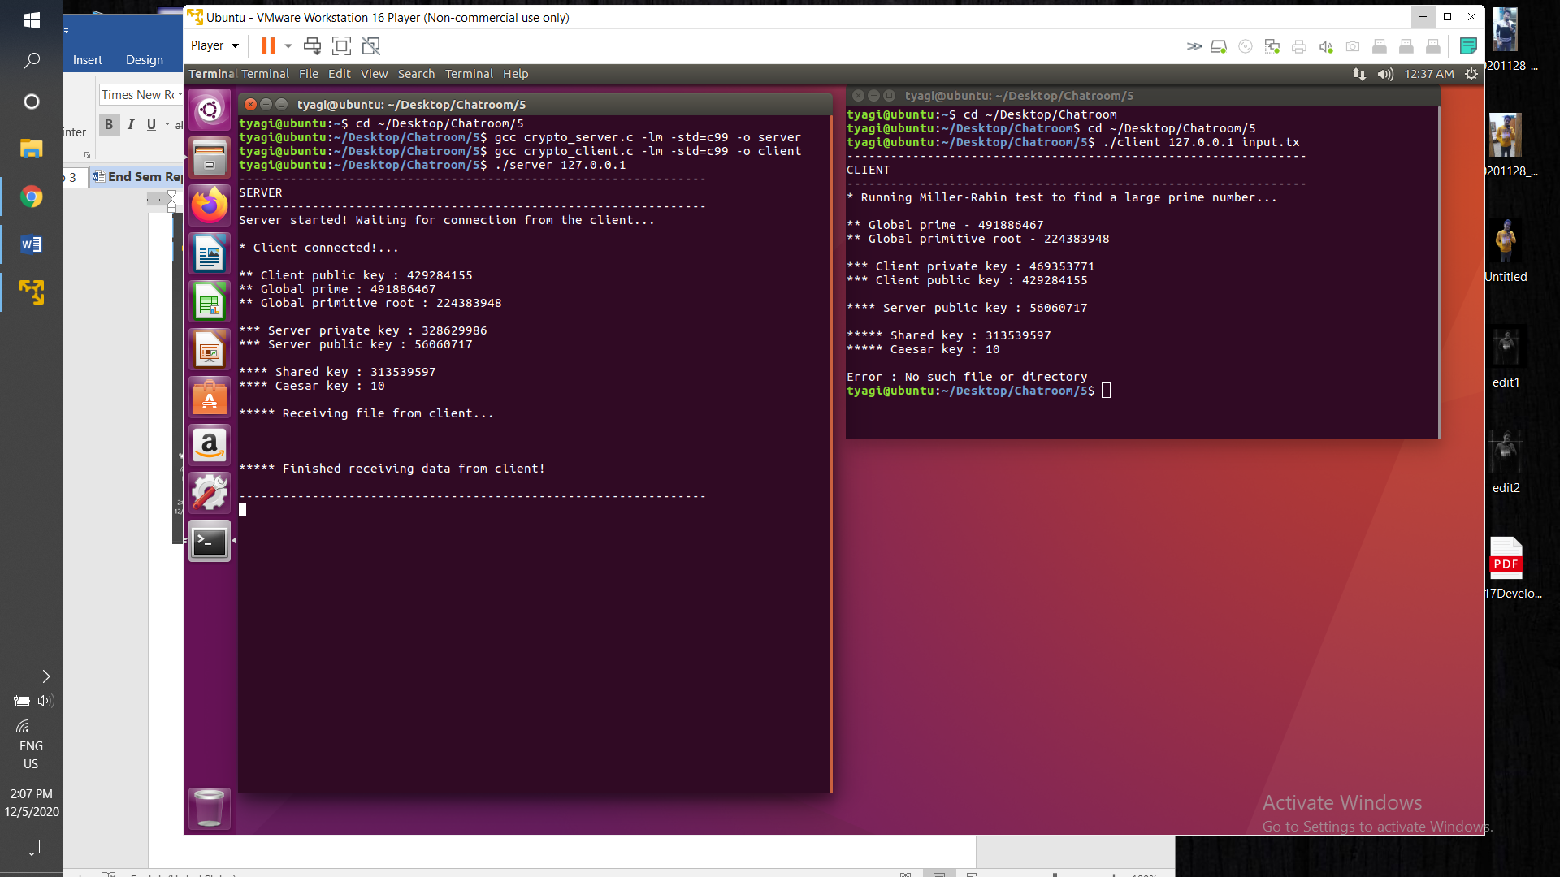
Encryption of data taking place
Here client sends a file which is then encrypted and key details are also shown

Slide 22
OBJECTIVE
To create a chatroom with secured communications in order to ensure confidentiality and security of user data.
Achieved
Creation of chatroom
Secret Key creation using Diffie Hellman Key
Encryption, Decryption of messages.

Slide 23
PERT CHART
Phase 2(Updation)
October-Novemebr
Phase 1: September-October
Client Server
Interaction
Client Server
Interaction
Start: Requirement Analysis
(August)
Final
Version
End
(November)
Version 1
Socket Programming
Socket Programming
End to End encryption
implementation

Slide 24
References
[1] https://www.geeksforgeeks.org/socket-programming-cc/
[2] https://en.wikipedia.org/wiki/Diffie%E2%80%93Hellman_key_exchange
[3] https://www.youtube.com/watch?v=fNerEo6Lstw
[4] https://github.com/nikhilroxtomar/Chatroom-in-C
[5] https://en.wikipedia.org/wiki/End-to-end_encryption

Slide 25
Thank You!!!

